Slide 1

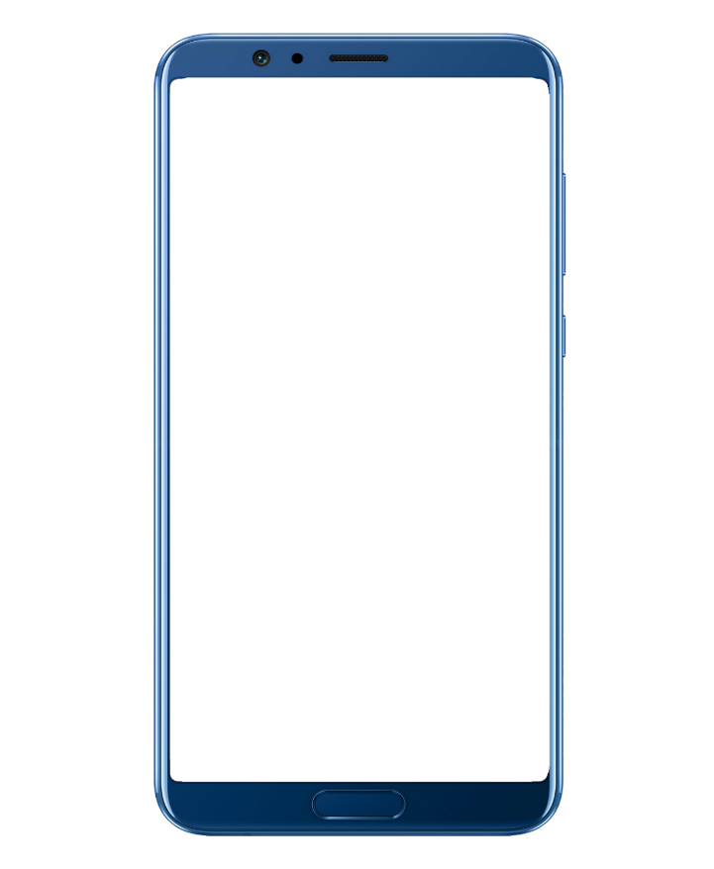
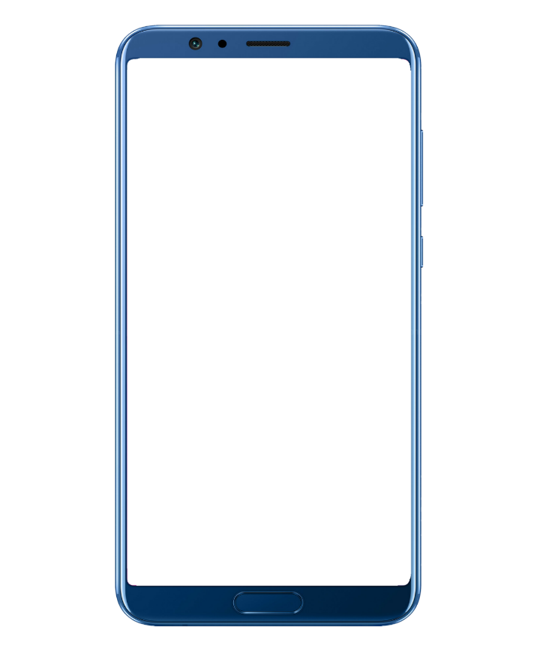
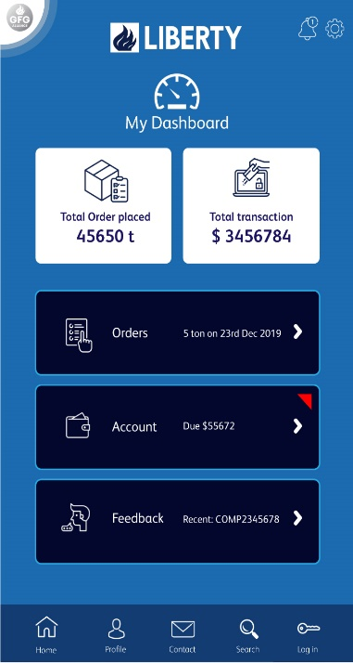

PROTOTYPE
Wireframing of proposed app will give an idea about UI/UX.
For Interview of flutter candidate

Slide 2

APP LANDING PAGE
Background with Liberty brand symbol of spokes. It will be very subtle without creating any visual obstruction.
Information slides controlled by admin panel.
Though there are options to either register or sign in, user can also enter anonymously.
For Interview of flutter candidate

Slide 3
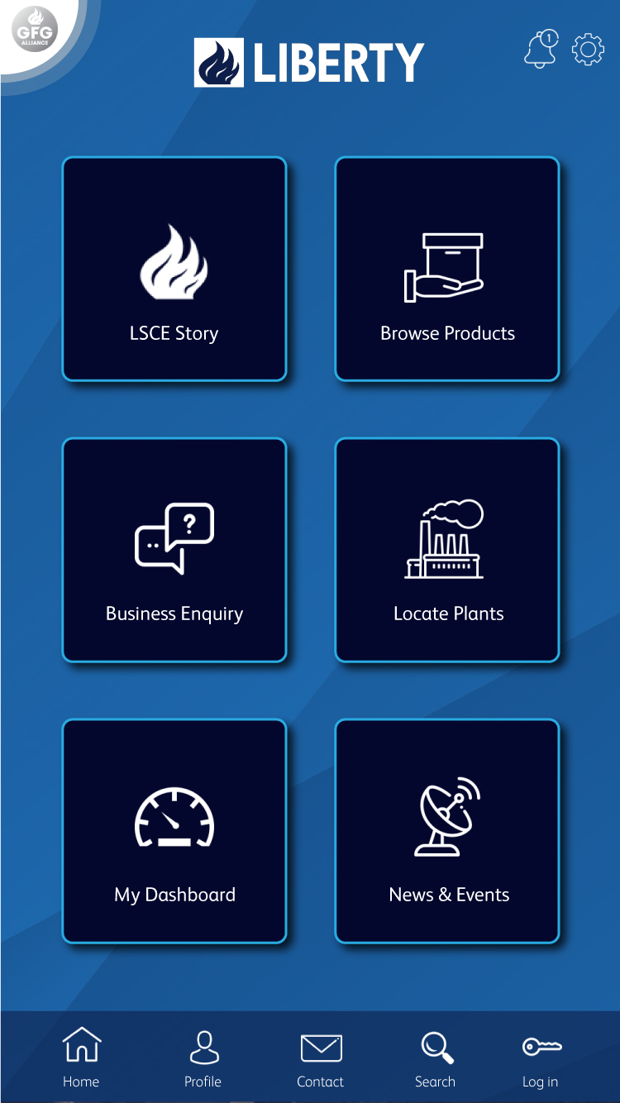
APP HOME
#04072d
6 major segments.
Instead of conventional burger menu top left menu icon is represented by GFG logo. It will have a pulsating animation to catch user’s attention. Main menu will be opened once clicked.
Bottom navigation panel helps user to open essential components like profile, contact, search and login section.
For Interview of flutter candidate

Slide 4
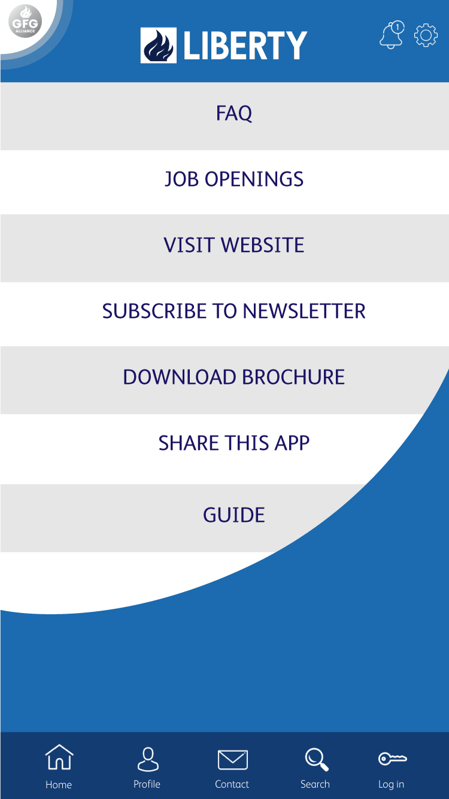
MAIN MENU
Opening of main menu will have fluid animation.
Main menu contains all generic items and can be accessed by anonymous user.
#133c72
For Interview of flutter candidate

Slide 5
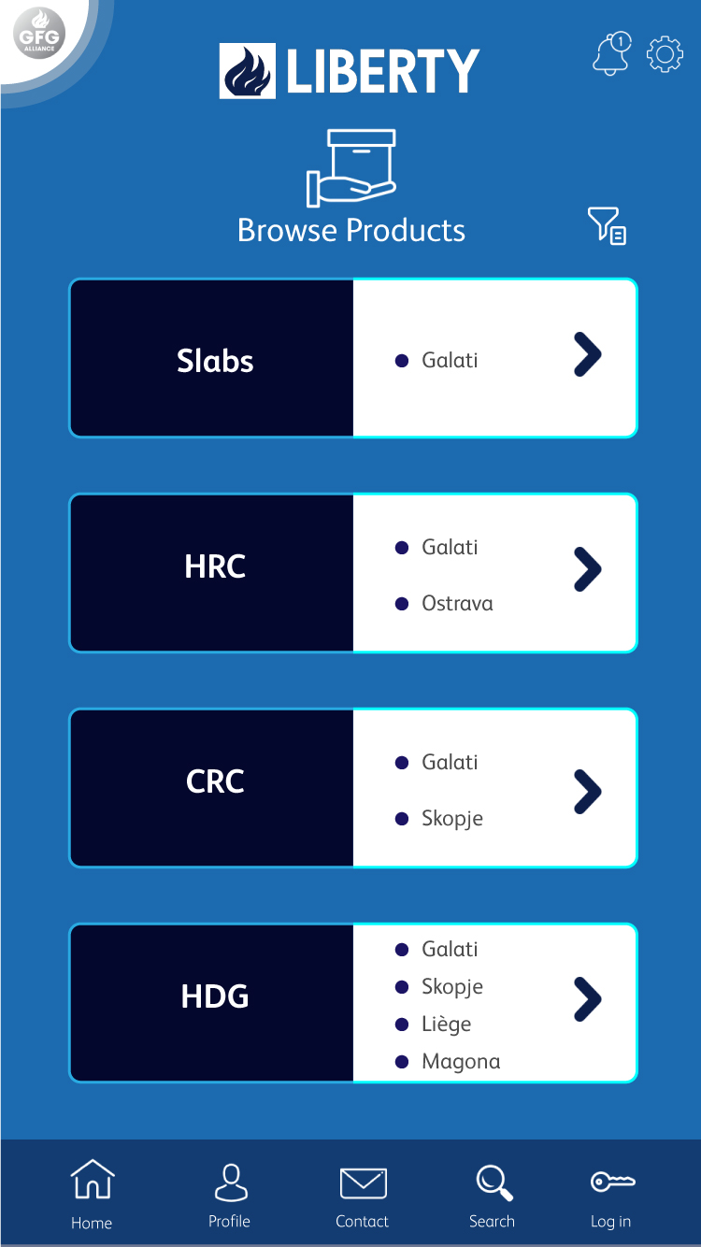
PRODUCTS
User will have option to browse products along with plant details.
Filter option will help to search a product with specifications.
For Interview of flutter candidate

Slide 6
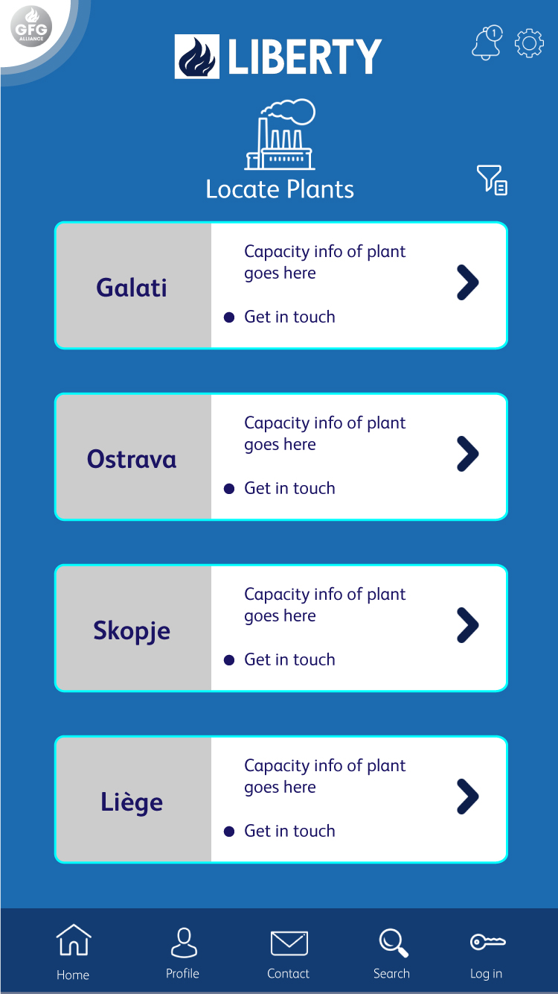
PLANTS
User can get plant specific information.
User can contact to plant-id directly.
Plant specific information can be filtered.
For Interview of flutter candidate

Slide 7
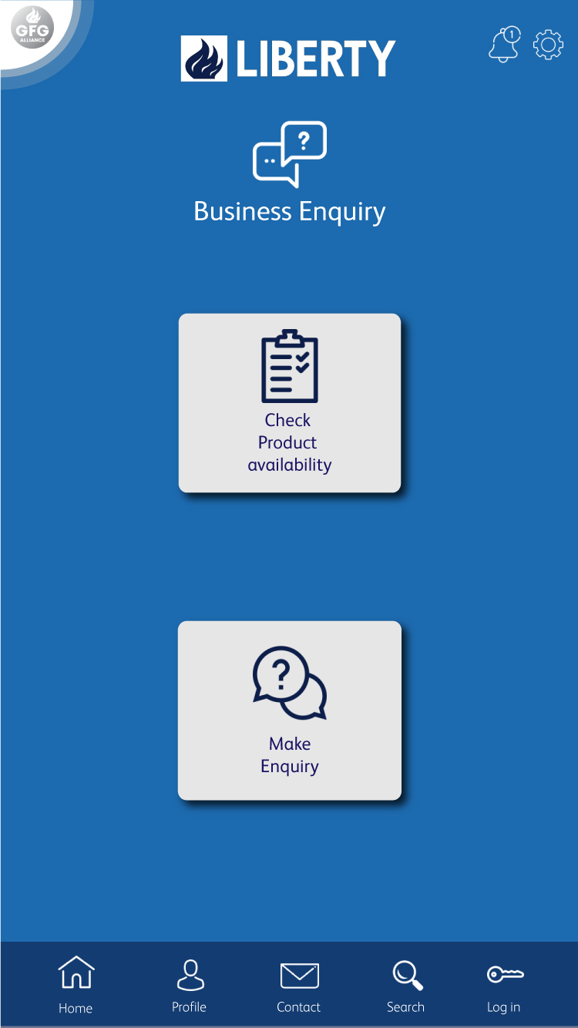
BUSINESS ENQUIRY
Option to check product availability
Based on availability user can make a business enquiry.
In case of anonymous user they can check product availability but making a business enquiry will need them to register or login.
For Interview of flutter candidate

Slide 8
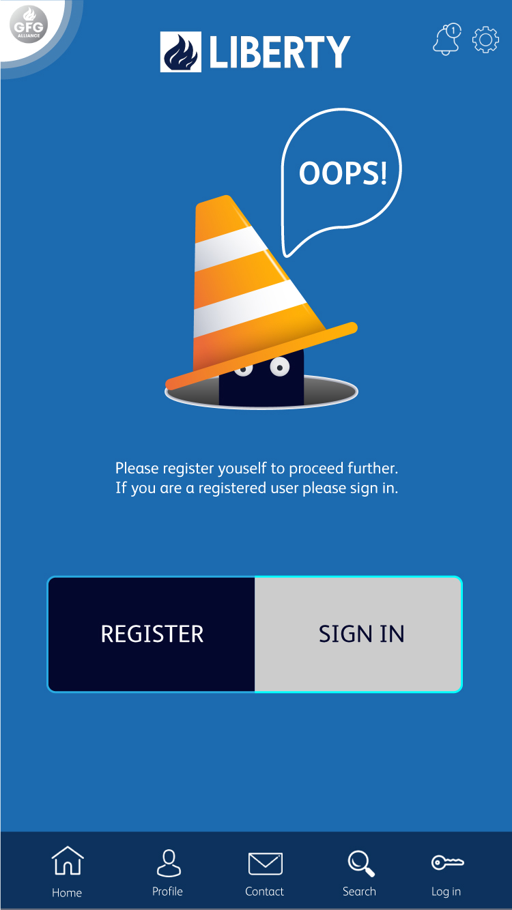
REQUEST TO LOGIN
Anonymous user will be redirected to this page for either register or login.
For Interview of flutter candidate

Slide 9
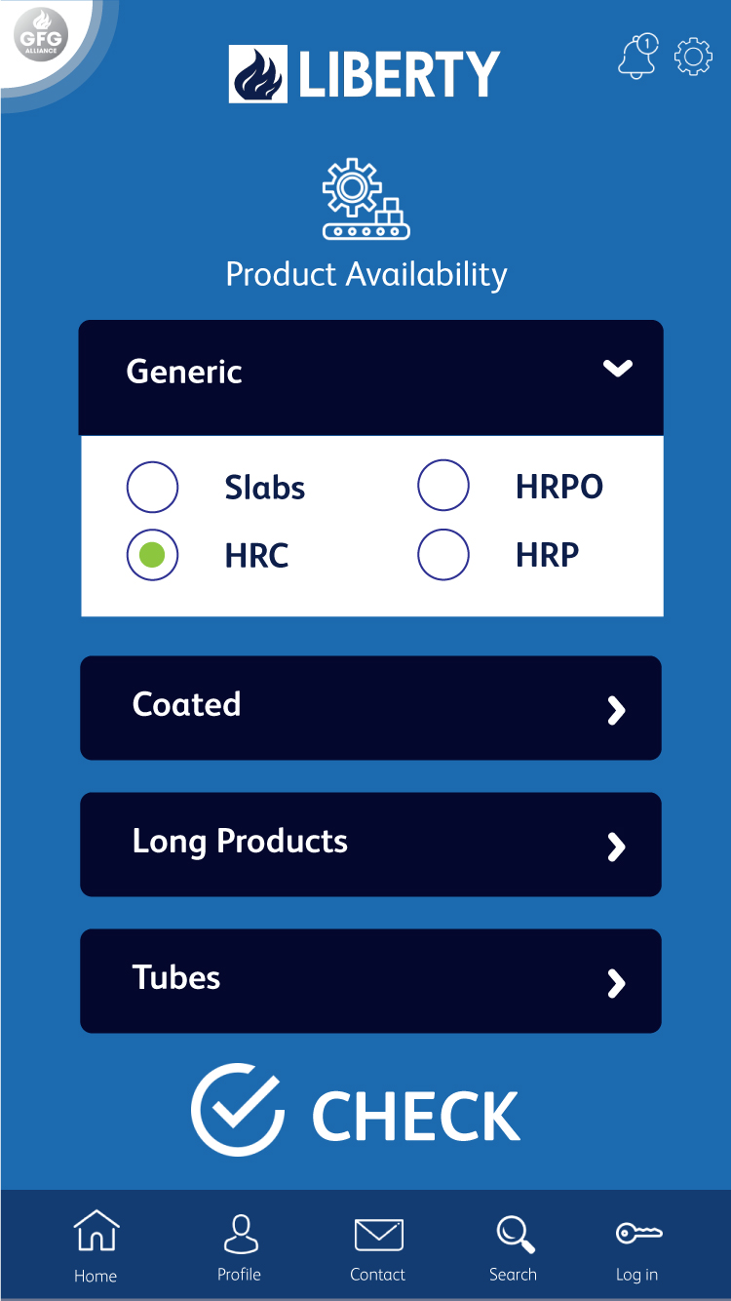
AVAILABILITY CHECK
Category wise product availability can be checked from this interface.
For Interview of flutter candidate

Slide 10
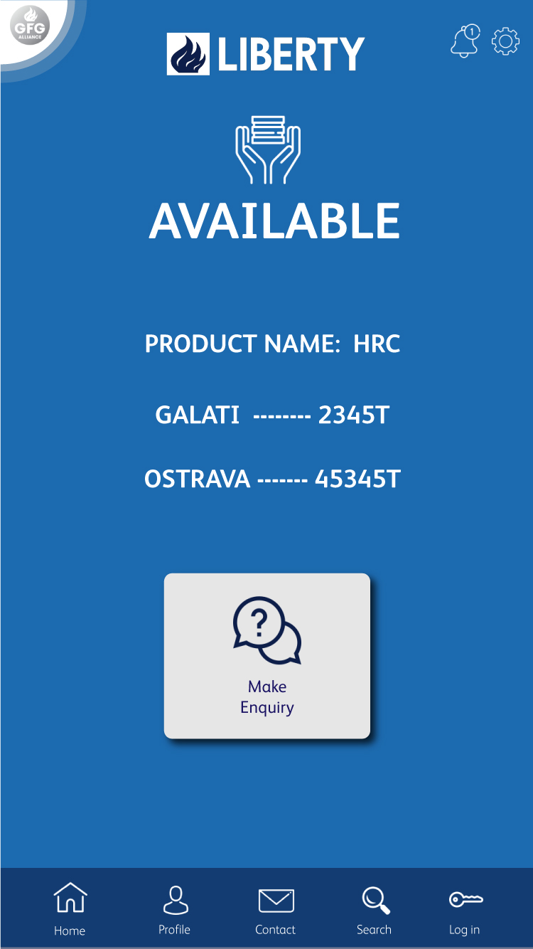
AVAILABILITY RESULT
Location wise availability result can be obtained.
For Interview of flutter candidate

Slide 11

USER DASHBOARD
User can obtain total transaction summary.
Three most important features for user – Order details with tracking, Accounts and Feedback.
For Interview of flutter candidate

Slide 12
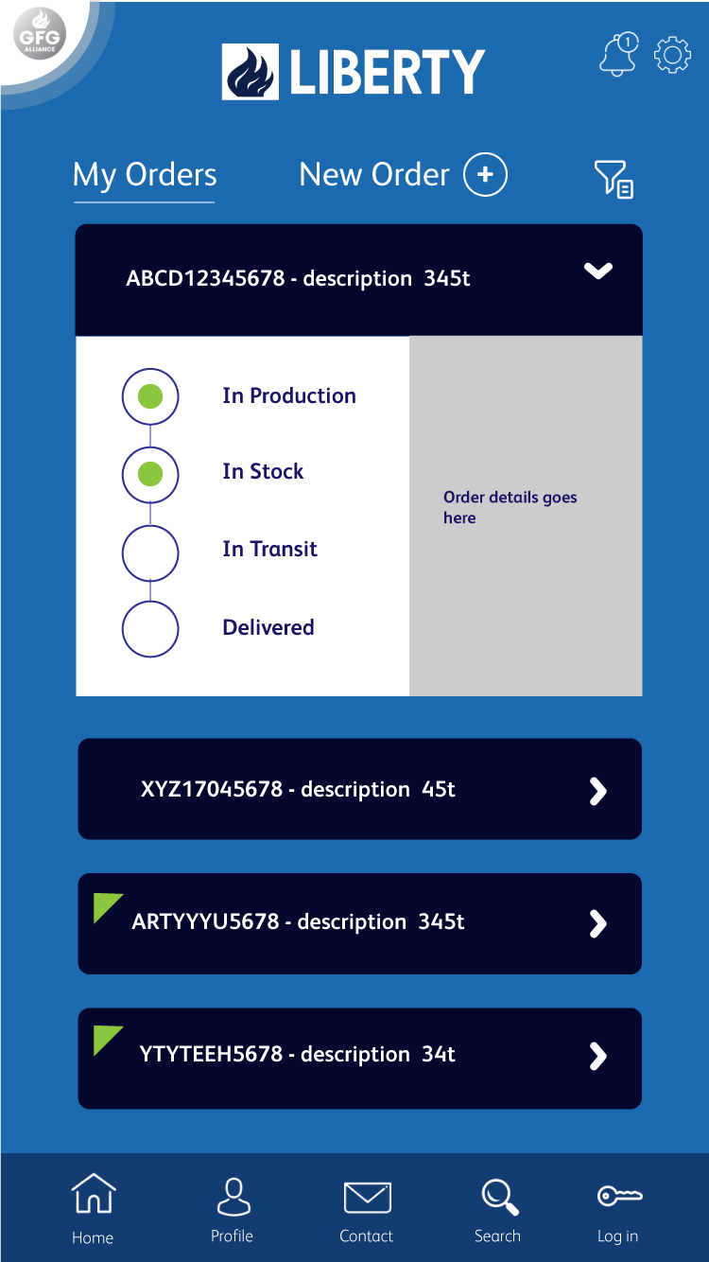
ORDER TRACKING
User can track placed order with their current status.
Accepted order will have green mark whereas rejected order with have separate colour code.
User can place new order from this panel.
Orders can be filtered.
For Interview of flutter candidate

Slide 13
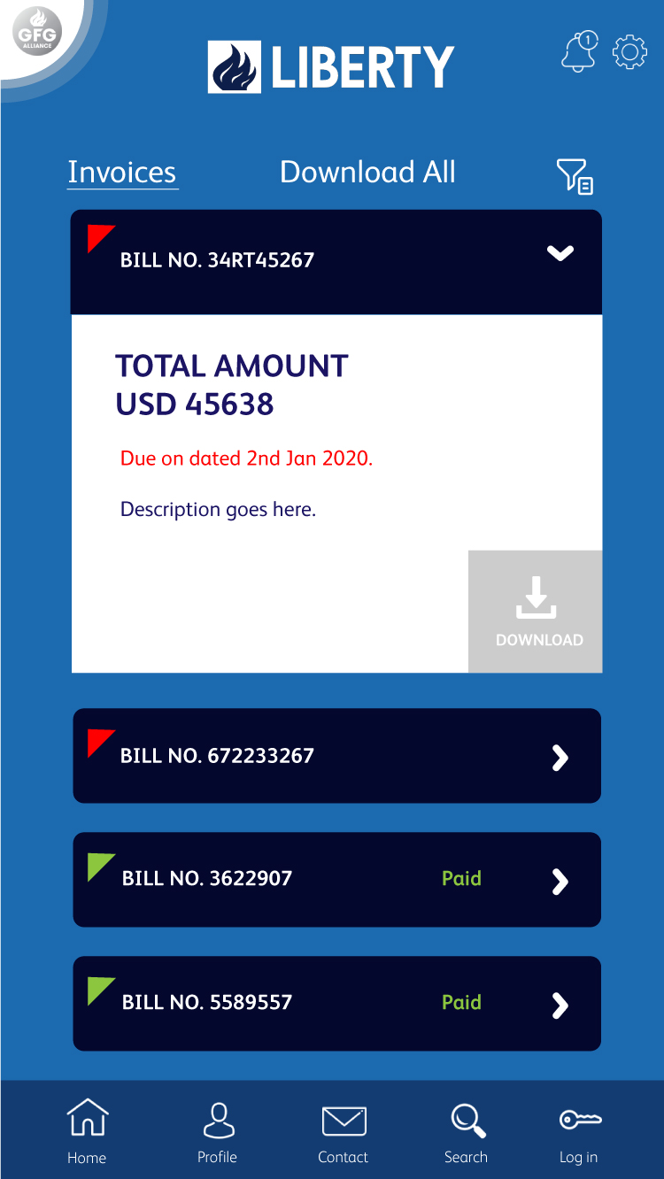
ACCOUNTS TRACKING
All transactions can be seen at one go.
Successful payment will marked with green colour whereas dues will be in red.
Transaction details can be downloaded.
Transactions can be filtered based on date, amount, status.
For Interview of flutter candidate

Slide 14
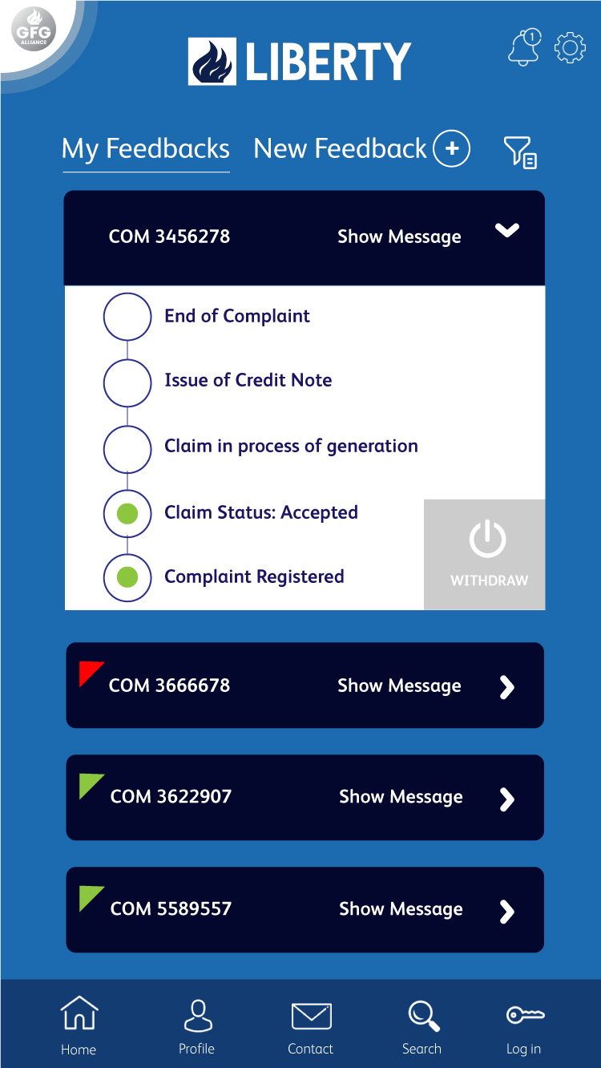
FEEDBACK TRACKING
User can track old feedbacks and also can initiate a new complaint.
Any time complaint can be withdrawn.
Colour indicator tells whether a feedback has been successfully resolved or pending.
For Interview of flutter candidate

Slide 15
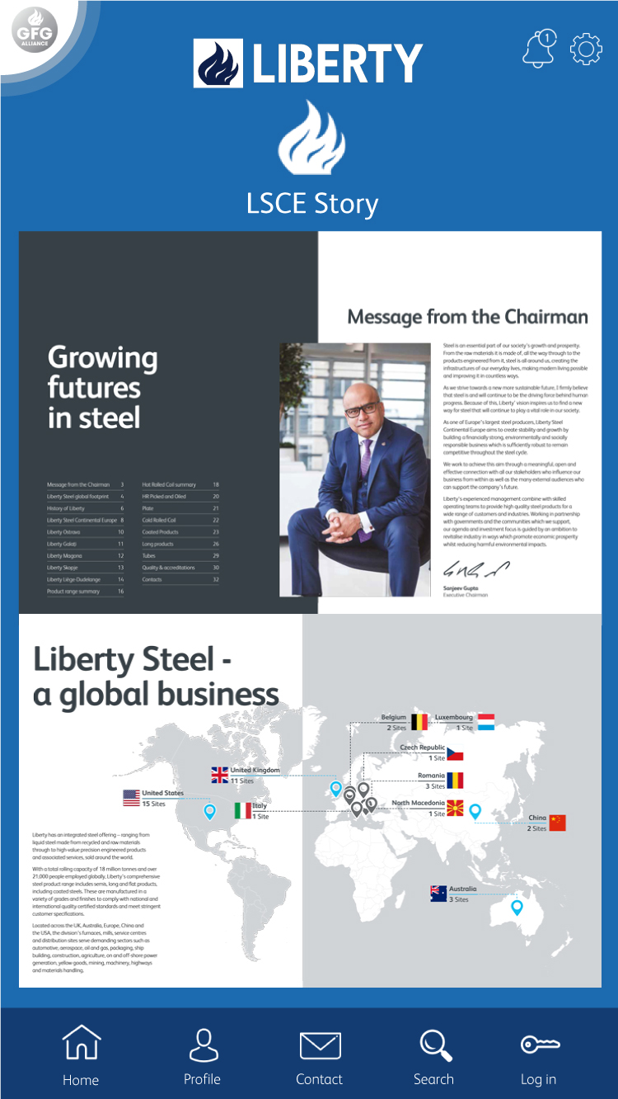
STORY
For Interview of flutter candidate

Slide 16
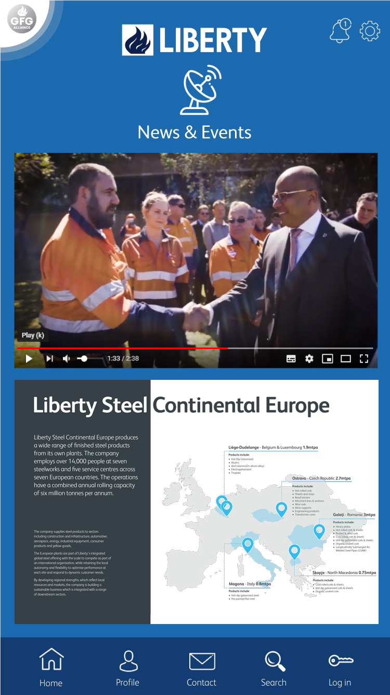
NEWS & EVENTS
For Interview of flutter candidate

Slide 17
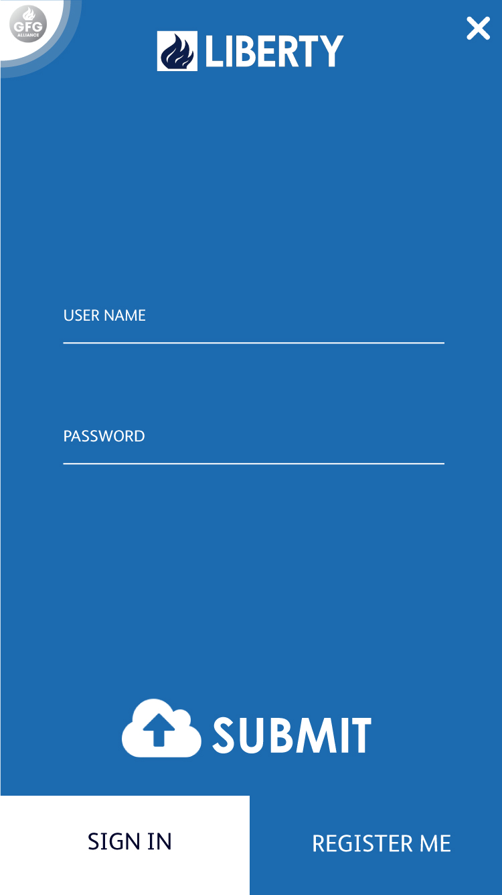
LOGIN
For Interview of flutter candidate

Slide 18
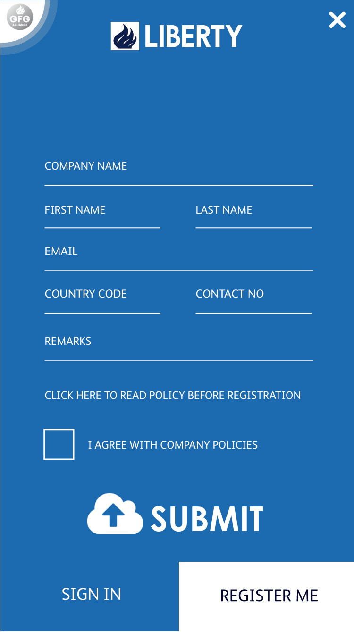
#1c6aaf
REGISTRATION
For Interview of flutter candidate

